Slide 1
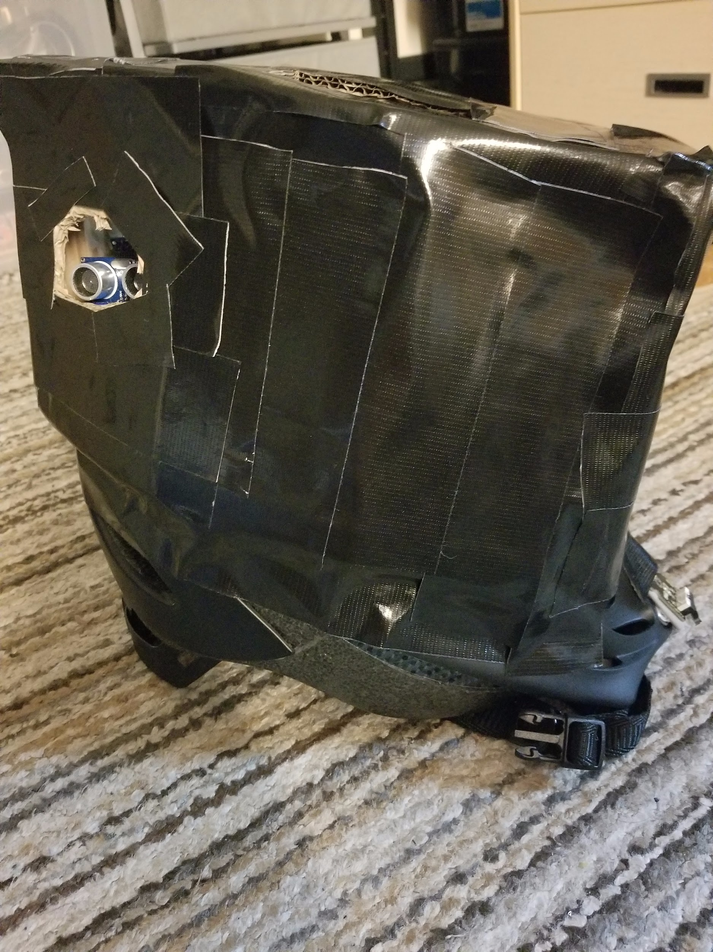
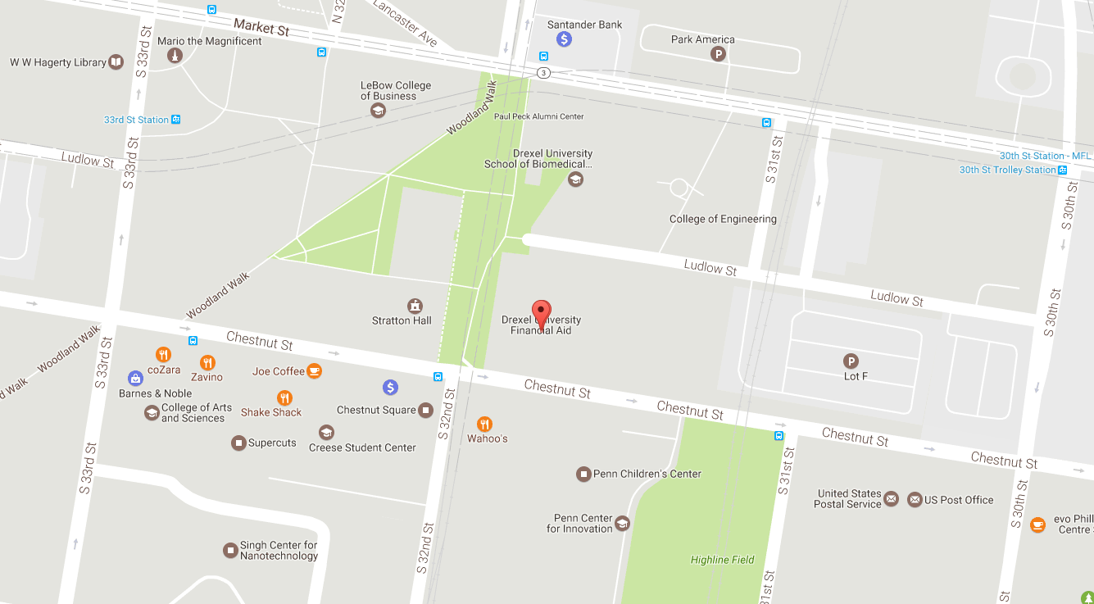
Elevate
A custom built safety helmet for recreational riders with a supported mobile application that supplements the riding experiencing.
CI 103 Phase
Team #46
Matthew Horger, Kevin Tayah, Jake Rauchen

Slide 2

Scope
Critical:
Helmet modules properly secured and installed
Mobile application functionality ported to a website (Javascript)
Database and Content Management System
Contact Business - Indego
Nice to have:
Port the website to a dedicated mobile application for Android
GPS/GPRS module for helmet for real-time data
More data provided for users of their ride (speed, distance traveled)
Future Considerations
Company outreach - IBX
Drexel University Skate Race

Slide 3
Helmet Demonstration
Helmet modules properly secured and installed - completed
Collision Sensor - completed
Battery Requirements - completed
Weatherproof Case - completed
GPS / GPRS - omitted due to budget and time constraints

Slide 4
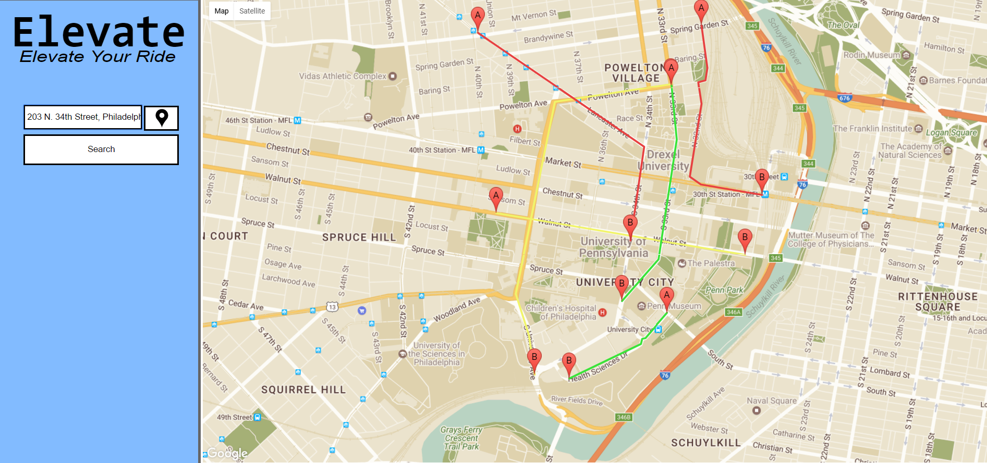
Mobile (Web) Demonstration
Mobile application functionality ported to a website (Javascript) - completed
Successful AJAX calls - completed
User Interface developed - completed
Route Mapping - completed

Slide 5

Backend Demonstration
Database and Content Management System - completed
Python Server to receive coordinates - completed
mySQL database to store coordinates - completed
Plone instance to deploy GPS map - completed
User accounts setup - completed
Network adapters to integrate services - omitted due to non-binary adapters and network restrictions from Drexel (port-forwarding).

Slide 6
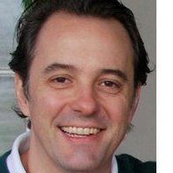
Company Outreach
Contact Business - Indego - completed
Never responded
Contact IBX - completed
Responded with great feedback
“... a great idea but too much of your environment that your product is going to be in is unpredictable and not able to be controlled… too much room for error especially with handling people’s safety… need to test thoroughly. ~ David Rowland, Sr Technical Program Manager at IBX

Slide 7
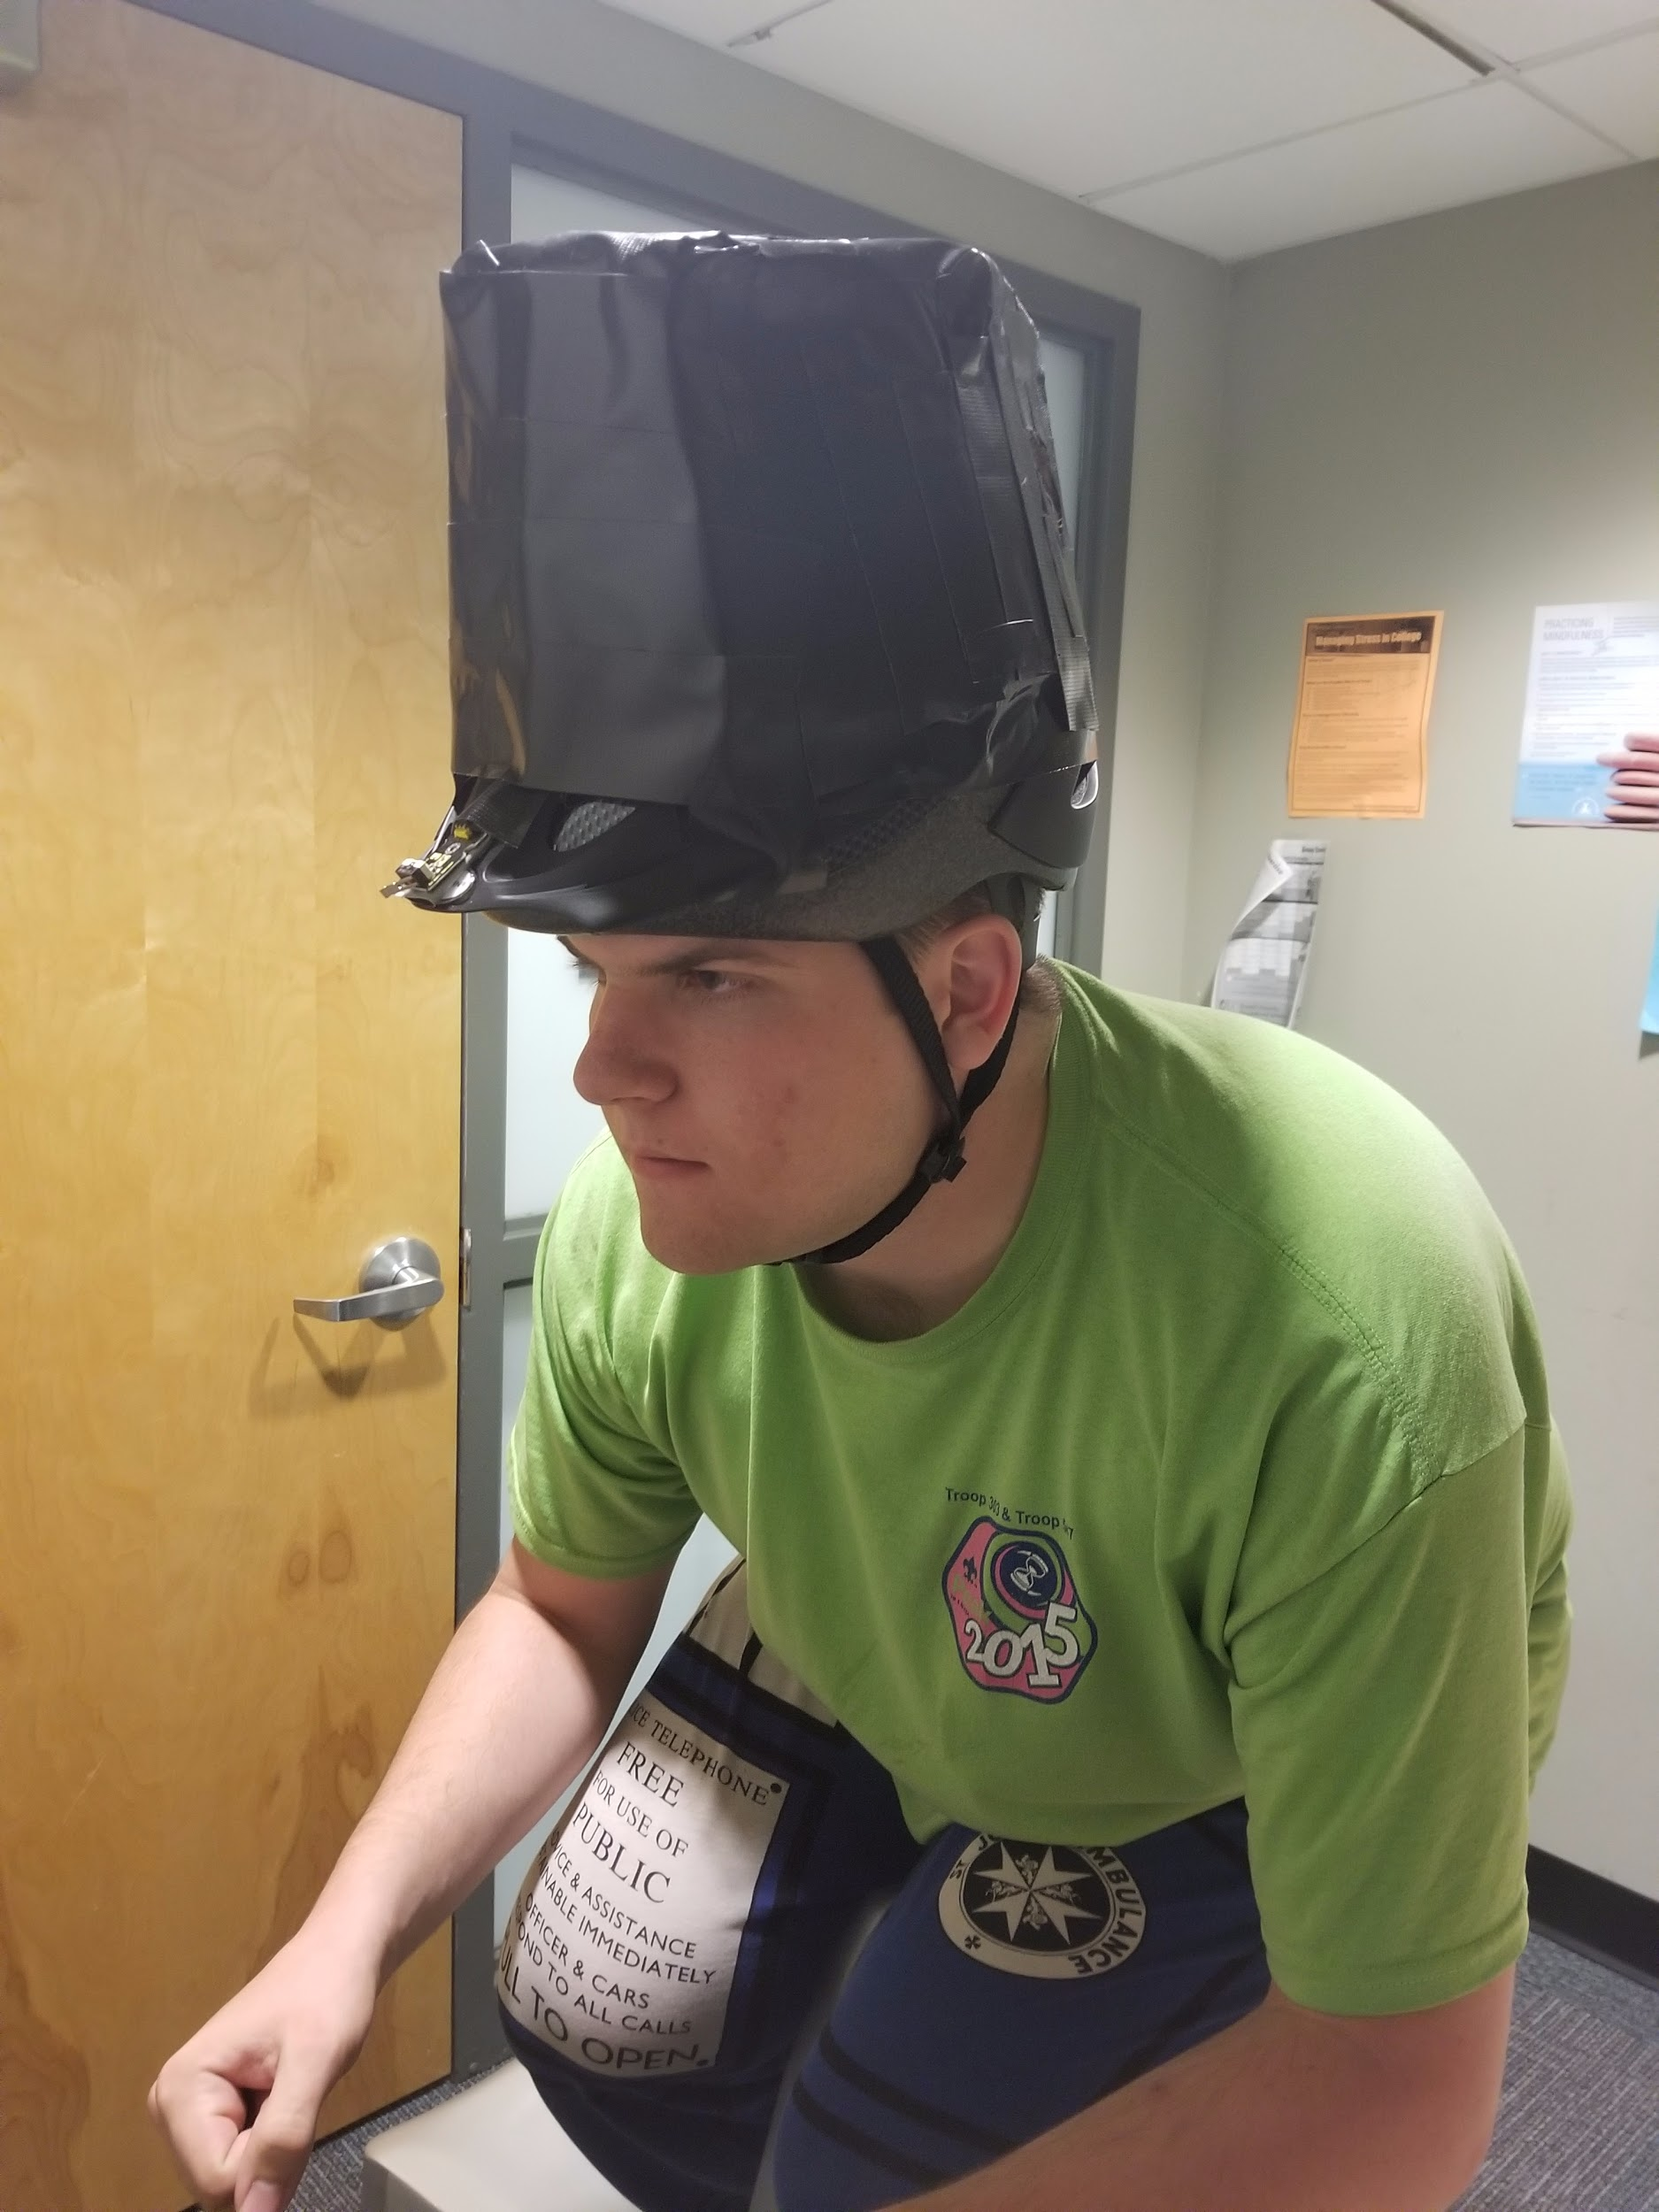
User Testing
Established Test Course within Dormitory Floor
Two participants
Each maneuvered through staged chairs and tables wearing helmet
Finished with collision in the study room
Results
Collision had to be light or else sensor would get damaged
Cardboard stayed intact when hit against wall with some force
Sensors were accurate within a range of 250 centimeters
Buzzer control was finicky

Slide 8

User Feedback
Surveyed 10 people who tried on the helmet - asked a few questions
8 people said helmet did not feel too bulky or heavy; straps and size were easily adjustable to fit head
5 people thought helmet would break upon real world collision - (we agree, it’s a prototype)
2 people said would forget to charge helmet / would use non-rechargeable batteries
1 person saw no application for their riding experience

Slide 9

Requirements Fulfilled
All Critical Scope Requirements - fulfilled to great extent
Developments finished
Successful testing and feedback
Indego did not respond
Nice to have Scope requirements - not included
Time constraints towards the end of the term
Budget constraints from the College of Computing and Informatics
Future Improvements - some included
IBX outreach
Skate Race would have to be planned out for 2017-2018 school year

Slide 10
Lessons Learned - CI102 and CI103
Always budget more than expected for development projects
Hardware costs typically more than software - eg, case, GPS modules
Time management and resource allocation is a key to success to overcome learning curve
Especially with complex networking and web development - eg, AJAX calls
Sometimes can hinder project development and push back timeline - eg, Database
Communication can make or break a project
Especially with idea forming and development work - eg, SMS, BitBucket
No established roles can sometimes lead to success within small teams
Each person brings valuable skills - don’t limit them to a particular role
User testing can be tricky yet rewarding if you plan carefully
Always consider what could go wrong - eg, helmet breaking

Slide 11
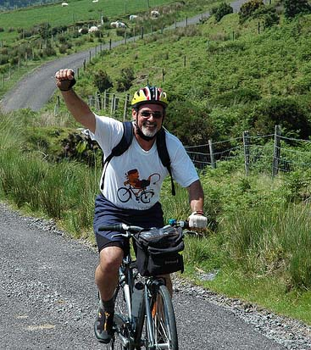
Continuing Development
Finish Nice to Have Requirements
Obtain GPS / GPRS modules to bring together project
Port forward Plone for accessibility for end users
Continue Mobile Application development
Commercial Research
Propose business budget for end user production
Find sponsor willing to assist us
SKATE RACE
Good Idea Fund - budget production for creation of helmets

Slide 12
Manuals
Systems Manual -
20 Page document describing our system components and process
Broken down into three sections (Helmet, Mobile, Database)
Can be obtained by contacting support@elevate.org
User Manual -
19 Page document helping users get started with their system
Broken down into the same sections
Can be obtained with systems manual
Thank you for your time and consideration

